Slide 1
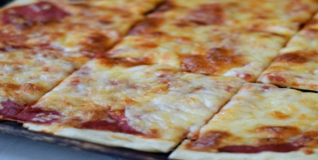
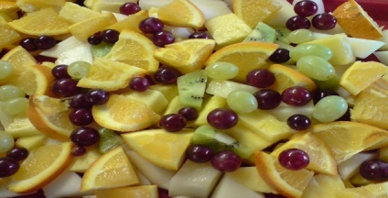
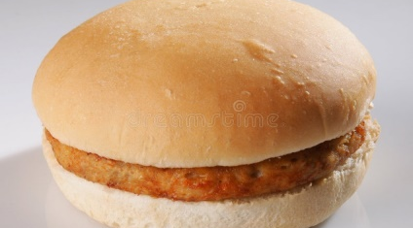
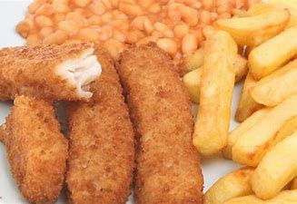
Your Menu This Week
Week 1 Commencing
2022
Main Dish
Vegetarian
Main Dish
Jackets
Dessert
Monday
Pizza, wedges & peas
Pizza, Wedges & peas
Jacket potato with Tuna or cheese with salad
Cookie or fruit
Tuesday
Mexican tortilla stack flavoured diced potatoes & sweetcorn
Vegetarian Mexican tortilla stack Potatoes & sweetcorn
Jacket potato with Baked beans with salad
Yoghurt or Fruit
Wednesday
BBQ Chicken fillet with roast potatoes & broccoli
Vegetarian sausage bean bake with broccoli
Jacket potato with Tuna or cheese with salad
Apple cake or fruit
Thursday
Chicken burger with coleslaw & salad
Vegetable burger with coleslaw & salad
Jacket Potato with Baked Beans with salad
Yoghurt or fruit
Friday
Fish finger with chips & beans
Cheese & potato bake with chips & beans
Jacket Potato with Tuna or cheese with salad
Chocolate Brownie or Fruit

Slide 2
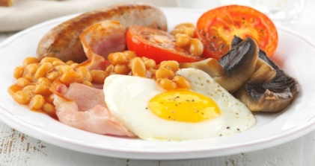
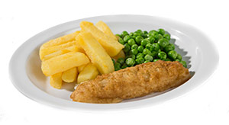
Your Menu This Week
Week 2 Commencing
2022
Main Dish
Vegetarian
Main Dish
Jackets
Dessert
Monday
Chicken Pasta, garlic bread, salad
Pasta & tomato sauce, garlic bread, salad
Jacket potato with Tuna or cheese with salad
Flapjack or fruit
Tuesday
Chicken curry, rice, green beans, Naan bread
Vegetarian curry, rice, green beans, Naan bread
Jacket potato with Baked beans with salad
Yoghurt or Fruit
Wednesday
Roast chicken dinner
Vegetarian chicken dinner
Jacket potato with Tuna or cheese with salad
Melting Moment or fruit
Thursday
All day breakfast
Vegetarian all day breakfast
Jacket Potato with Baked Beans with salad
Yoghurt or fruit
Friday
Fish portion with chips and peas
Toastie, chips & salad
Jacket Potato with Tuna or cheese with salad
Banana finger or Fruit

Slide 3
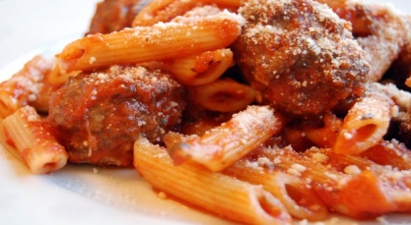
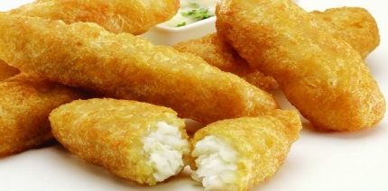
Your Menu This Week
Week 3 Commencing
2022
Main Dish
Vegetarian
Main Dish
Jackets
Dessert
Monday
Pizza, wedges & peas
Pizza, Wedges & peas
Jacket potato with Tuna or cheese with salad
Cookie or fruit
Tuesday
Chicken Fajita, diced potatoes, chopped salad
Vegetarian Chilli in a boat, diced potatoes & salad
Jacket potato with Baked beans with salad
Yoghurt or Fruit
Wednesday
Meatball pasta bake, garlic bread, broccoli
Vegetarian meatball pasta bake, garlic bread, broccoli
Jacket potato with Tuna or cheese with salad
Orange square or fruit
Thursday
Fruity Chicken curry, rice, green beans, naan bread
Tomato & mascarpone pasta, salad
Jacket Potato with Baked Beans with salad
Yoghurt or fruit
Friday
Fish strips, chips & peas
Quorn dippers, chips & baked beans
Jacket Potato with Tuna or cheese with salad
Chocolate Crunch or Fruit

