Slide 1


Stockport Autism Team
Cheryl Knupfer
Autism Team Manager

Slide 2
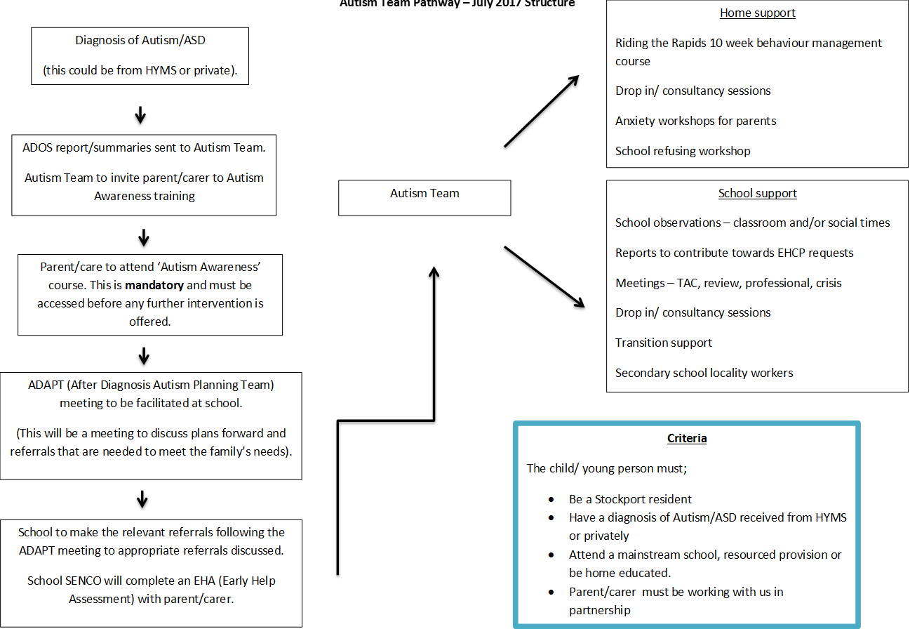
Referrals to the team

Slide 3
ADAPT
(After diagnosis autism planning team)
HYMS/ CDU send the ADOS assessment report to myself to allocate a lead for the ADAPT planning meeting from the Autism Team
The lead then contacts the school and arranges an ADAPT planning meeting in school with the SENCo and the parents to discuss the ADOS findings, the child’s strengths, difficulties, current concerns at home and school, discuss strategies and then create a plan. The school updates an EHA to request services if required and this process then falls in to the current TAC/review process
School and parents receive an ADAPT booklet signposting them to the local offer and to services/activities and general sources if support

Slide 4
Autism Awareness Training
Parents are invited to the course within a month of receiving their child’s diagnosis to gain a greater understanding of Autism
They gain information and strategies about how best to support their child/young person
They find out about additional sources of support in Stockport
If their child is displaying challenging behaviour we put them on the waiting list for our 10-week autism specific ‘Riding the rapids’ training
We send out any resources that are required

Slide 5

Riding the rapids training course
Riding the Rapids is a behavioural intervention based on well-researched principles of social learning theory and functional analysis.
Riding the Rapids was independently evaluated as part of a Department of Education funded study:
Managing Behaviour and sleep problems in disabled children: An investigation into the effectiveness and costs of parent-training interventions (2012) Beresford et al, Department for Education Research Report DFE-RR204
The course enables parents to understand their child’s behaviour in the context of their additional needs, and apply strategies to support positive behaviours. It also helps parents to develop stress management strategies and confidence in managing their child’s behaviour. The course is collaborative, so that parents develop tools they can take with them and continue to apply once the intervention is complete.
‘Have really enjoyed being in the
group, everyone supporting each
other, you’re not on your own’
'It’s been brilliant – so much taught in such a fun way’
‘Wonderful – every session is so helpful’
“I really enjoyed all the course, felt it has helped me to be a better mother and a more confident mother.”

Slide 6



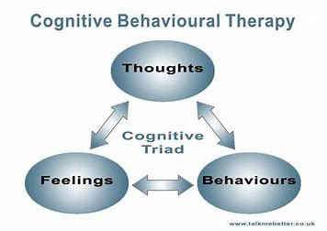
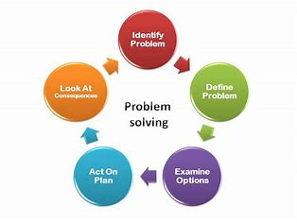
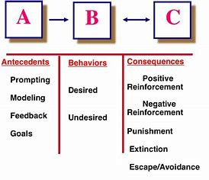
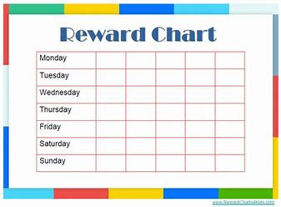
Riding the rapids materials

Slide 7
Additional team roles
Lead practitioner Training for parents - Limited diet/ Coping
Chair TAC meetings Family contracts – boundaries/routines
Train staff
1-1 work with young person
Train/support other staff/teams
ADOS trained – 4 x staff
Secondary school link worker role
Family support

Slide 8
Secondary school link worker role
We carried out a pilot project in Stockport school in the Summer term of 2017. We assigned a designated Autism Intervention worker to be based in the school for one full day per week.
Identified each young person with a diagnosis and create a one-page profile for them, cascaded this information to staff (online register to ensure all staff are familiar of their needs, triggers and strategies.
Their role was to train staff, run small group sessions with young people, 1-1 work to develop coping strategies and resilience, run a transition group and support staff, attend reviews and run ADAPT meetings.
Adapt the environment - lunch clubs, quiet area etc.

Slide 9
Role out of school link worker role
Assigned a worker for every secondary school in Stockport
Formed key relationships with staff
Keep updated about young people
Able to deliver crisis intervention
Developed a traffic light system
re level of intervention required
Fantastic feedback

Slide 10
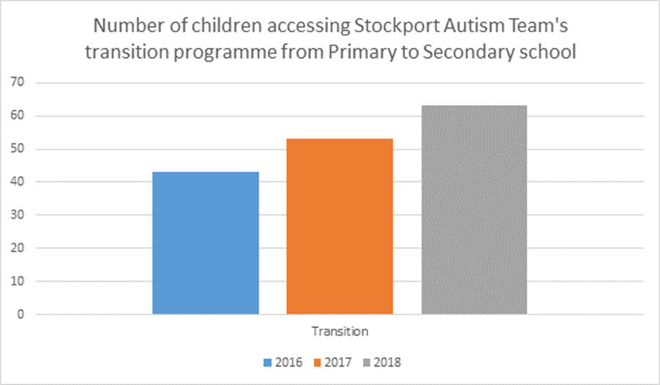
Transition support from primary school to secondary school
One page profile
Pack about secondary school for young person
Parental questionnaire
Attend year 5/6 reviews
Additional visits
Link worker meets with SENCo
Run groups in the summer term at the secondary school to meet other students, to work through worries and prepare them

Slide 11
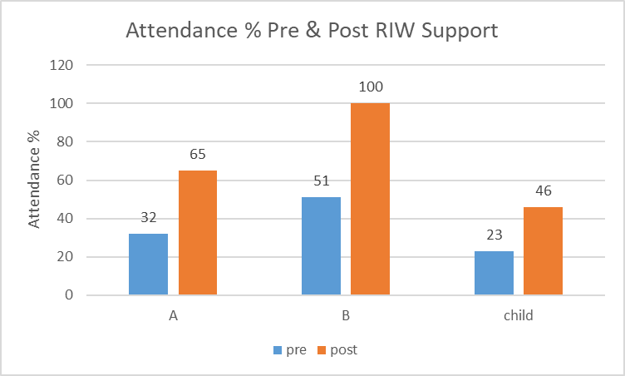
Autism Re-Integration Workers
We have 2 workers (45 hours in total) who carry out intensive support when a young person is school refusing
The worker will work under the direction of one of our Autism Intervention Workers to support parents/carers in implementing boundaries and routines
The worker will support the young person to discuss the issues regarding their school and link with the school to create a plan to help get the young person back in to school

Slide 12
Autism Steering Group
Meets three to four times per year
Representatives include: Paediatrician, Psychiatrist, EP, SALT, Myself, BSS, IS, Parent reps
The group makes decisions and oversees subgroups – Education and training, Assessment and Intervention these groups meet every eight weeks
Examples of work completed; re-designed pathway, created school training package, mapping exercise to ensure all intervention uses evidence based practice, reduced waiting times and increased quicker post-diagnostic support

Slide 13
THE AUTISM TEAM
Team Manager – Cheryl Knupfer
autismteam@stockport.gov.uk
0161 474 2553
Team Supervisor – Michelle Tonge
Autism Intervention Workers:
Jenny Kemp Fran Arthurs
Zoe Lamb Roisin Gore
Rosie Peters Jennie Everhard
Joanne Lynch
Katharine Slack
Helen Bulloch
Rhiannan D’Ambra
Autism Re-integration Workers:
Honor Furey
Stephen Keiley
Head of Service
Heidi Shaw
Principal Lead Integrated Services (Education)
Heaton and Tame Valley Locality
Stockport Family
Boroughwide Services:
Mosaic and Young Peoples Education and Advice Service

Slide 14

Any questions?
Thank you

